Slide 1
Capacity building of local operators, managers regarding the maintenance of clean energy technologies.
Lecture – 5

Slide 2
_{Outline of course} Management of Micro Level Clean Energy Projects
Introduction to project management for clean energy system at micro level.
Functions of project based management: scope of work, project organization, quality, cost and duration
Tools and techniques of project-based management
Project life cycle. Processes of project management. Types of management
Methods of selecting sustainable clean energy technologies for the household, community.
Social, economical and technical impact of selected clean energy technologies
Financial analysis of clean energy technologies. Barriers. Micro-financing, subsidy.
Capacity building of local operators, managers regarding the maintenance of clean energy technologies.
Project management of micro level clean energy projects (such as MHP, SHS, wind energy for electricity generation and irrigation, biomass gasifiers etc.).

Slide 3
Sustainable energy for all
The technology should be
Affordable
Reliable
Accessible
Clean
Low carbon
Low PM
Low SOx, NOx
Low in carcinogenic content (e.g. MTBE- methyl tertiary butyl ether)
Renewable sources
Energy efficient
Energy conservation
Provide consumer empowerment

Slide 4
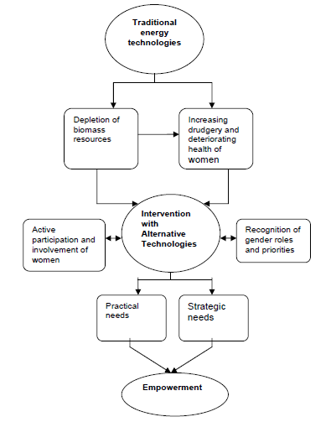
Gender and rural energy: An empowerment model
There is a need of intervention of clean energy technologies to replace traditional indigenous technologies.
This will not only save energy (fuel) but also reduce expenditure of human energy.
Women are encouraged to be involved in social and economic activities for their self-enhancement and empowerment.
Source: Rural_Energy_Technologies_Mahat.pdf
Notes:
Due to the limitations of traditional indigenous technologies, there is a need for interventions, which help to reduce women’s labour and time, which could be used for other productive purposes, and to improve the health conditions of women.
For this purpose, an intervention with AETs is needed. Such intervention should be based on recognition of gender concerns at both macro and micro level in terms of recognising women’s roles and responsibilities and their priorities regarding rural energy, and increasing participation of women from planning to implementation of AETs. The focus should be on reducing expenditure of human energy rather than only saving fuel.

Slide 5
CAPACITY BUILDING ON
CLEAN ENERGY TECHNOLOGIES
AWARENESS
CAMPAIGN
HUMAN RESOURCE
DEVELOPMENT
R & D ON CLEAN
ENERGY TECH
PROMOTION
QUALITY ASSESSMENT
DATABASE ON CLEAN
ENERGY TECHNOLOGIES
Notes:
Awareness campaign:
What: potentiality of biomass, need for fuel switching, health impact
How: school curricula, seminar, workshop, use of mass media
Who: institutions/schools, NGOs, INGOs, CBOs, local government
Human Resource Development (use/repair/maintain/develop):
Mobile training, Institutionalize trainings, On the job training, Field visits, Institutionalise R & D for adaptive research
Fuel technology and device improvement:
Improvement of existing and new fuel technology, Development and improvement of devices for fuel, Improved kitchen management, Involvement of institutions in R & D
Promotion:
Advertisements, Pilot projects, Marketing (price, efficient firewood management, rise of living standard), Incentives (bank loan, subsidy). Any BET that is affordable, efficient in firewood management and increases the living standard of users will be promoted easily.
Quality assessment:
Standard for fuel, Standard for devices used for cooking and heating, Skill testing of manpower,
Database on biomass energy technologies:
Types of fuel used, Biomass energy technologies, Manpower, Potentiality of biomass, Environmental aspect,Institutions involved in R & D

Slide 6
CAPACITY BUILDING (BIOMASS)
Awareness campaign:
What: potentiality of biomass, need for fuel switching, health impact
How: school curricula, seminar, workshop, use of mass media
Who: institutions/schools, NGOs, INGOs, CBOs, local government
Human Resource Development (use/repair/maintain/develop):
Mobile training
Institutionalize trainings
On the job training
Field visits
Institutionalise R & D for adaptive research
R & D on clean energy technology :
Improvement of existing and new fuel technology
Development and improvement of devices for fuel
Improved kitchen management
Involvement of institutions in R & D

Slide 7
CAPACITY BUILDING (continued)
Promotion:
Advertisements
Pilot projects
Marketing (price, efficient firewood management, rise of living standard)
Incentives (bank loan, subsidy)
Quality assessment:
Standard for fuel
Standard for devices used for cooking and heating
Skill testing of human resource
Database on biomass energy technologies:
Types of fuel used
Biomass energy technologies
Human resource
Potentiality of biomass
Environmental aspect
Institutions involved in R & D

Slide 8
QUALITY ASSESSMENT
Input
Process
Output
Outcome
Input: Raw materials (solid, liquid, gas fuels), cooking and heating devices.
Process: Users are trained to use improved BETs.
Output: Biomass users are switched to more efficient and environment friendly biomass fuels.
Expected outcome: Stakeholders of biomass energy technologies are benefited and improved
BETs are penetrated in the market and ultimately GHG is reduced.
Quality = customer satisfaction + continuous improvement + system quality

Slide 9
Capacity building of local operators/managers
Manpower for
Manufacturing
Marketing/sales
Installation
Operation/ maintenance
Design
Research & development
Training levels
School
Awareness programs (general public)
Technical training
Training of trainers
Graduate studies (diploma, bachelors, MSc., PhD)
On the job training
Institutions
Infrastructure/ facilities

Slide 10
Capacity building of local operators/managers
Manpower for
Training levels
Institutions
Energy supply companies
Equipment manufacturers
Regulators
Banks/ financial institutions
Government
Consulting organizations
Academic institutions
NGOs/ INGOs
Skill testing division
Infrastructure/ facilities
Training centers
Laboratories for testing
Models, prototypes

Slide 11
Maintenance management
Maintenance – ensuring that physical assets continue to do what their users want them to do.
Maintenance Management – to manage maintenance, i.e., to do more with less (reduce head counts).
Objective of Maintenance: to keep sufficient plant running at minimum direct and indirect costs to meet the production requirements

Slide 12
WHEN TO DO MAINTENANCE AND REPAIR?
Efficiency is down
Safety below desired level
Accuracy lost
Functional requirement not achieved
Downtime cost more than repair cost
Life of system can be enhanced

Slide 13
WHEN DOES THE COMPONENT FAIL?
Mean time between failures
No. of failures
Earliest failure
Time between machine failures
Components do not fail in regular interval
Show a range of time in which a failure takes place
Graph like shown above helps to get the mean times between failures to allow replacement

Slide 14
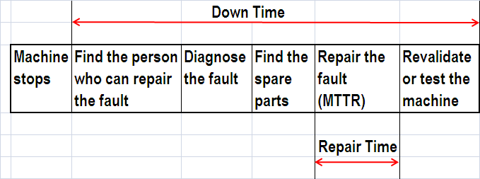
Difference between MTTR and total downtime

Slide 15
Maintenance, repair and operations
Maintenance, repair and operations (MRO) or maintenance, repair, and overhaul involves fixing any sort of mechanical, plumbing or electrical device should it become out of order or broken (known as repair, unscheduled, or casualty maintenance).
It also includes performing routine actions which keep the device in working order (known as scheduled maintenance) or prevent trouble from arising (preventive maintenance).
MRO may be defined as, "All actions which have the objective of retaining or restoring an item in or to a state in which it can perform its required function.
The actions include the combination of all technical and corresponding administrative, managerial, and supervision actions."
https://en.wikipedia.org/wiki/Maintenance,_repair,_and_operations

Slide 16
The basic function of a maintenance management system
Preventive maintenance
Plant and unit record (equipment)
Inventory and spare parts control system, purchasing system
Document record
Planning system for maintenance and work order routines
Technical/economical analysis of plant history, maintenance and machine availability
http://www.slideshare.net/Bisina/maintenance-management

Slide 17
Maintenance types
Generally speaking, there are four types of maintenance in use:
Preventive maintenance, where equipment is maintained before break down occurs.
Operational maintenance, where equipment is maintained in using.
Corrective maintenance, where equipment is maintained after break down. This maintenance is often most expensive because worn equipment can damage other parts and cause multiple damages.
Adaptive maintenance, where equipment is maintained by letting it adapt to new environment.

Slide 18
EFFECT OF MAINTENANCE
Effective maintenance
Non-effective maintenance
Restore system productivity
Avoid any unnecessary shutdown
Increase the efficiency of equipment
Prolong the system life
Improve the overall plant productivity
Essential to maintain product quality
Increases plant profit
Increased maintenance cost
Reduced the system/equipment life
Reduced the efficiency of heat transfer
Induced the unwanted waste
Additional cost to clean the system
Can effect product quality
Reduced the plant productivity
Downgraded the system effectiveness
Decreased plant profit
Source: www.maintenanceresources.com

Slide 19
MAINTENANCE COST
Maintenance cost can be divided into two main groups.
Direct costs, which are easy to justify and to report. These direct costs consist of items such as labor, materials, services, and maintenance overhead cost are the cost tabulated and shown as maintenance costs.
Indirect costs (hidden costs) which are harder to measure. These hidden cost of maintenance are classified as the six big losses:-
Breakdowns and unplanned plant shutdown losses
Excessive set-up, changeovers and adjustments losses
Idling and minor stoppages
Running at reduced speed
Startup losses and
Quality defects

Slide 20
MAINTENANCE MANAGMENT
Selection of maintenance strategy
Finding resources
manpower,
equipment/tools,
spare parts
Maintenance administration
A hierarchy of authority and responsibility for deciding what, when and how work should be carried out
Work planning and control system
A mechanism for planning and scheduling the work and feeding back the information
Allocation of budget

Slide 21
MAINTENANCE CREW
Manufacturers are very reluctant to down time. Any downtime in plant is direct production loss which nobody want. Every factory manager wants the downtime to minimum. To achieve this you require skilled manpower in your maintenance department.
Normally a gang of four to five people including a foreman, an electrician, a fitter and one or two helpers are minimum requirement for shift coverage.
Plant manager along with his engineer schedules a maintenance plan which can be implemented on weekly/fortnightly/monthly basis.

Slide 22
Task
Prepare a maintenance schedule of following clean energy technologies:
Solar home system (Solar PV)
MHP
Wind power
Biogas

Slide 23
References
http://www.ese.iitb.ac.in/~rb/Publications/Conference%20proceedings%20papers/Capacity%20Building.pdf
http://www.maintenanceresources.com/referencelibrary/maintenancemanagement/index.htm
http://www.nrel.gov/analysis/tech_lcoe_re_cost_est.html

